Slide 1
Peer to Peer File Transfer
Group 7:
Trần Đắc Minh BI10-113
Đặng Gia Linh BI10-101
Trần Hoàng Minh BI10-119
Lê Duy Anh BI9-034
Đoàn Đình Nam BA9-045

Slide 2
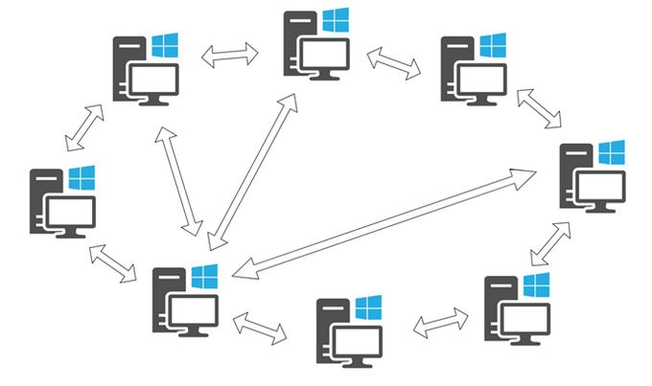
INTRODUCTION
In Computer Networking, P2P is a file-sharing technology. It first came into existence in the late 1970s, allowing the users to access mainly the multimedia files like videos, music, e-books, games, etc. The individual users in this network are referred to as peers. The peers request files from other peers by establishing TCP or UDP connections.

Slide 3
Why do we use P2P file transfer
To share resources and help computers and devices work collaboratively.
The most common use is the sharing of files on the internet.
They are ideal for file sharing because they allow the computers connected to them to receive files and send files simultaneously

Slide 4

How P2P file transfer works
(our version)
Centralized Directory
An architecture
supported by the P2P systems

Slide 5
Centralized Directory
Somewhat similar to client-server architecture
All the peers inform this central server of their IP address and the files they are making available for sharing (published).
The server queries the peers at regular intervals to make sure if the peers are still connected or not.

Slide 6
Operations
Whenever a requesting peer comes in, it sends its query to the server.
The server has all the information of its peers, so it returns the IP addresses of all the peers and published files to the peer.
The file (published files) transfer takes place between these two peers. Therefore each peer will act as both a server and a client.

Slide 7
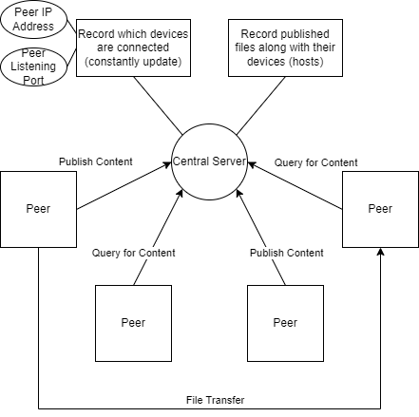
P2P File Transfer Diagram

Slide 8
Implementation
We build our peer nodes and central server using C language.
C language has powerful libraries supporting networking. Especially Socket Programming.
Necessary Libraries
#include<stdio.h> <stdlib.h> <string.h> <sys/types.h> <sys/socket.h> <netinet/in.h> <netdb.h> <errno.h> <arpa/inet.h> <signal.h>

Slide 9
Demo

Slide 10
Conclusion
P2P file transfer has both
advantages and disadvantages

Slide 11
P2P Network Advantages
No need for a network operating system
Does not need an expensive server because individual workstations are used to access the files
No need for specialist staff such as network technicians because each user sets their own permissions as to which files they are willing to share.
Much easier to set up than a client-server network - does not need specialist knowledge
If one computer fails it will not disrupt any other part of the network. It just means that those files aren't available to other users at that time.

Slide 12
P2P Network Disadvantages
It can slow down the performance for the user
Files and folders cannot be centrally backed up
Files and resources are not centrally organised into a specific 'shared area'. They are stored on individual computers and might be difficult to locate if the computer's owner doesn't have a logical filing system.
Ensuring that viruses are not introduced to the network is the responsibility of each individual user
There is little or no security besides the permissions. Users often don't need to log onto their workstations.

Slide 13
Future Improvement + Ideas
Optimized central server to be able to handle more Peer nodes at once time.
Reorganize the database to make it easier to maintain.
Add more error and exception handlers in the code to make the system more stable.
Maybe add more options for users to interact with the system other than query and transfer file.
Maybe make an GUI for easier use.

Slide 14
THANKS FOR YOUR TIME

